Slide 1

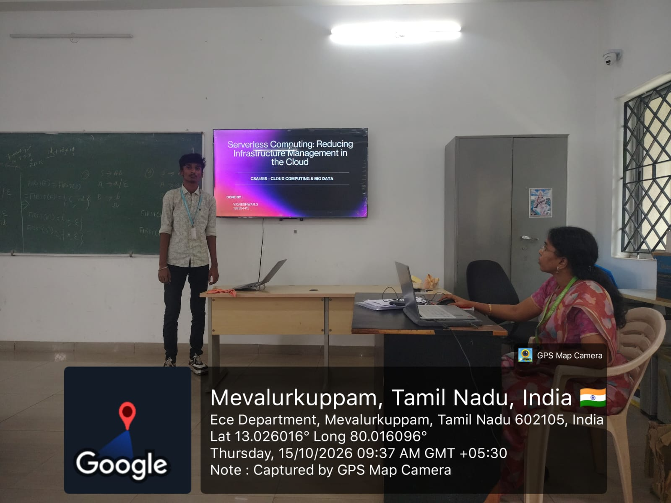

Slide 2
Serverless Computing: Reducing Infrastructure Management in the Cloud
CSA1515 – CLOUD COMPUTING & BIG DATA
DONE BY :
VIGNESHWAR.D
192524415

Slide 3
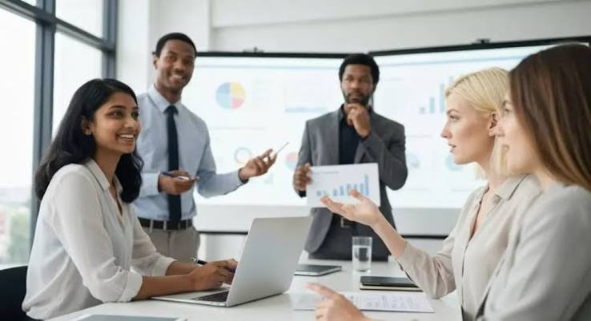
INTRODUCTION
Cloud applications need to handle different levels of activity throughout the day.
Traditional systems require teams to set up, manage, and scale servers.
With serverless computing, the cloud provider manages much of the underlying infrastructure.
The cloud platform can adjust resources to match demand, and costs are generally based on usage.
This presentation explains how FaaS works, where businesses use it, and how it can process an uploaded image.

Slide 4

What Does “Serverless” Mean?
Serverless computing is a cloud model where the provider manages the servers, operating system maintenance, capacity, and scaling.
The servers still exist; developers simply don’t manage them directly.
Function-as-a-Service (FaaS) lets developers deploy small units of code that run when triggered by a request or event.
Functions are usually designed to handle one task. Applications store lasting data in databases or object storage.
wExamples: AWS Lambda, Azure Functions, Google Cloud Run functions.

Slide 5
FaaS Architecture

Slide 6

What Happens When a Function Runs?
A developer deploys the function and connects it to a trigger.
An event arrives with the information the function needs.
The cloud platform runs the function and scales capacity to handle demand.
The function processes the event and returns a result, saves data, or sends another event.
The platform records execution details for monitoring and troubleshooting.

Slide 7

Industry Relevance :
Retail and e-commerce: Process orders, respond to payment webhooks, or resize product images.
Finance: Process transaction events, flag suspicious activity, or send alerts.
Media: Process uploaded files, create thumbnails, or prepare video content.
IoT and manufacturing: Process sensor messages and trigger alerts or actions.
Software and data teams: Run scheduled jobs, webhooks, and data-processing steps.

Slide 8
THANK YOU !

